Slide 1
Leroy Jenkins Bot
Blake Sakaluk, Lexie Bartlett, and AJ Sharpe

Slide 2
Zerg-Rush Strategy
We have a four-pool Zergling rush strategy.
It creates an initial Zergling rush and then Sunken Colonies for defense
It then sends reinforcements as necessary and builds economy up.

Slide 3
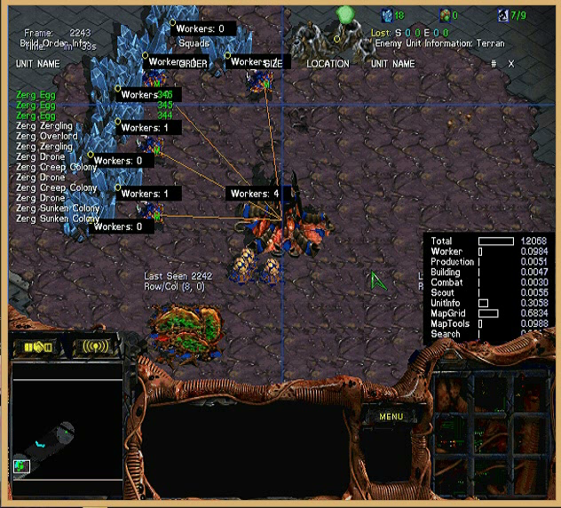

Slide 4
Why it works?
It’s very effective at overwhelming enemy forces before they have a chance to create any significant defenses
We also made some changes to the bot’s attacking decisions to make it more effective.

Slide 5
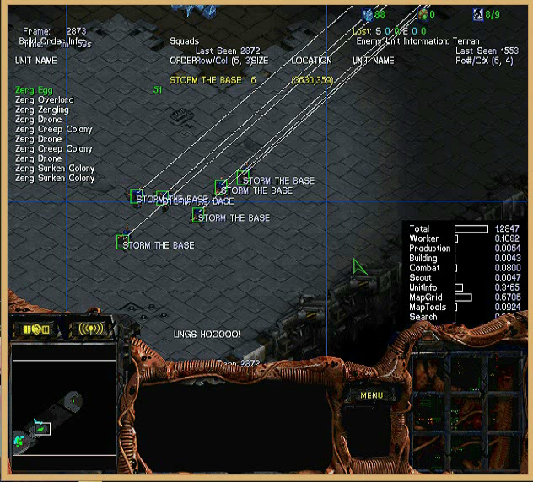
Storm The Base
- It finds the location of the enemy base and runs there as fast as possible.

Slide 6
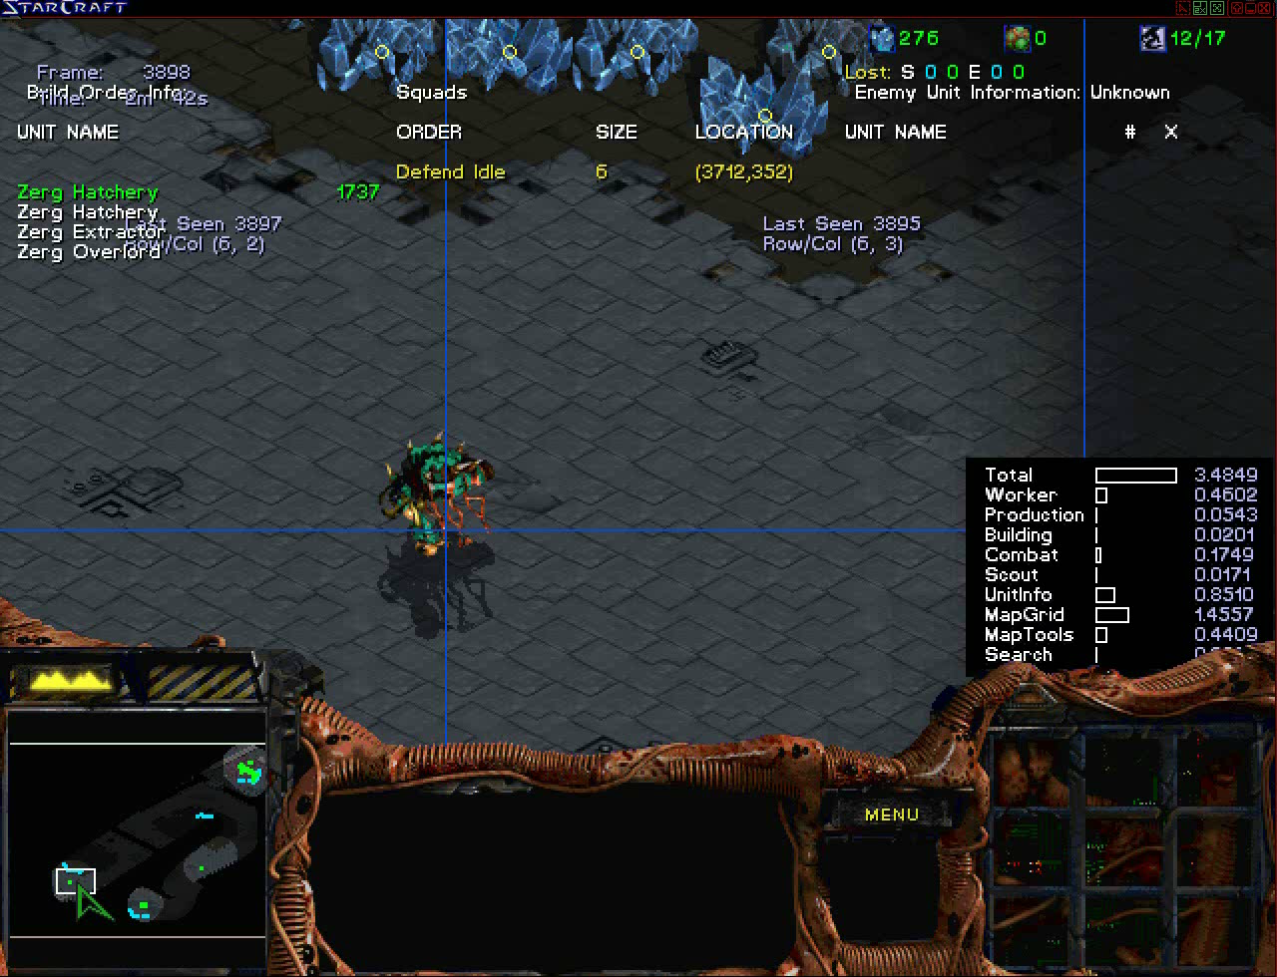
Overlord Scouting
Traditional UAlbertaBot scouting is done using workers which is not effective when playing Zerg as workers are morphed into buildings.

Slide 7
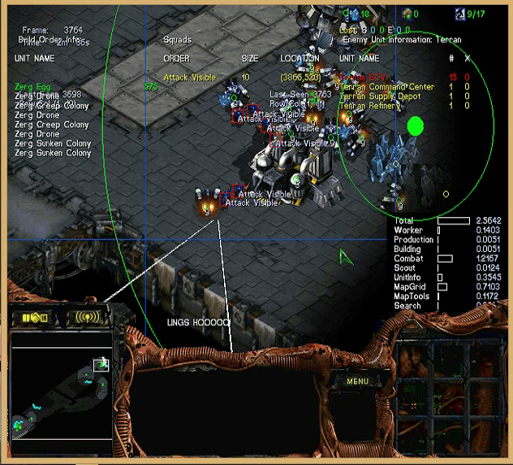
Lings Ho!
This was implemented to take advantage of Zergling’s cheap and quick creation.
The idea is that Zerglings are is expendable and a squad shouldn’t retreat until it has faced heavy losses in order to do as much damage to the enemy as possible

Slide 8
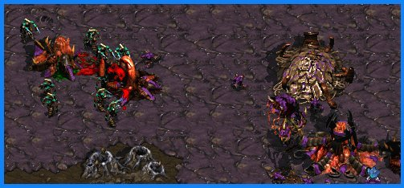
Sunken Colonies
Sunken colonies are the most useful early game Zerg ground defense so we use them as our primary defensive structure
The ones shown here, however, are about to be destroyed by Zealots

Slide 9
Results
Zergling Rush is an extremely effective strategy.
It works best against bots/players that are more interested in late-game strategy and economy building.
It also is particularly more effective on the two person maps then the three or four person maps
It works well on Protoss and Terran because it takes them much longer to get out this many combat units.
These results were gained by running our bot against the 2014 AIIDE bots we had a fairly good win rate against most of the bots though the strategy still wasn’t good against Ximp, IceBot and UAlbertaBot

Slide 10

Overpool Strategy
This strategy is closely related to the four-pool rush but focuses more on economy development in early game
Takes advantage of the ability of Zerg to expand easily and quickly

Slide 11
Why it works?
Takes advantage of the typical scouting mechanics in AI that only scouts one position rather than the whole map by expanding many times early on.
Sets up for mid game Hydra play as well as, hopefully, breaking the enemy economy with an early Zergling run-by.

Slide 12
Results
Zergling Rush is an extremely effective strategy.
It works best against bots/players that are focusing on early game all in type of strategies
It works well against bots that don’t scout the entire map

Slide 13

Build Order Search Fix
The build order wasn’t fully functional for Zerg in UAlbertaBot so we completely redid it
The new build order search manager doesn’t exactly ‘search’ for a build order so much as generate a list of necessary items to achieve a goal.
Runs very fast as it only needs to work backwards along a line of items from a goal.

Slide 14
Future Work
Implement the build order search to work for Zerg in the same manner as it does for Protoss
Improve path-finding for more efficient rushes
Add in more/improve on current strategies to make the UCB decision making better
Make it send taunts to the enemy like a real player would
Potentially take this bot too the 2015 AIIDE tournament

Slide 15
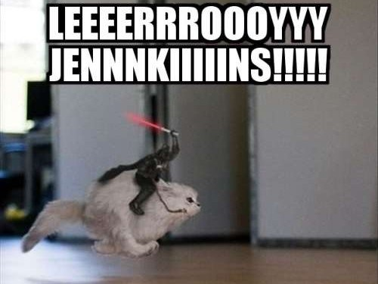


Slide 16
Picture sources:
Sunken Colony: http://www.battlereports.com/viewreports.php?reportnum=6321
Bob the builder:
http://en.wikipedia.org/wiki/List_of_Bob_the_Builder_characters
Leroy Jenkins:
http://weheartit.com/tag/leroy%20jenkins

Slide 17
Questions?

